Slide 1

Network Intrusion Detection using Deep Learning
Hemanth Koganti

Slide 2
Introduction
Critical Component of Network Security
Increase in demand
High False Positive rates for Pattern Matching Algorithms

Slide 3
Dataset and Preprocessing
NSL-KDD Dataset
Features such as protocol type, service, flag, duration etc.
125973 Training Samples and 22544 Testing Samples.
Normalization of numerical features and one-hot encoding of categorical features.
K-fold cross validation

Slide 4

Exploratory Data Analysis

Slide 5
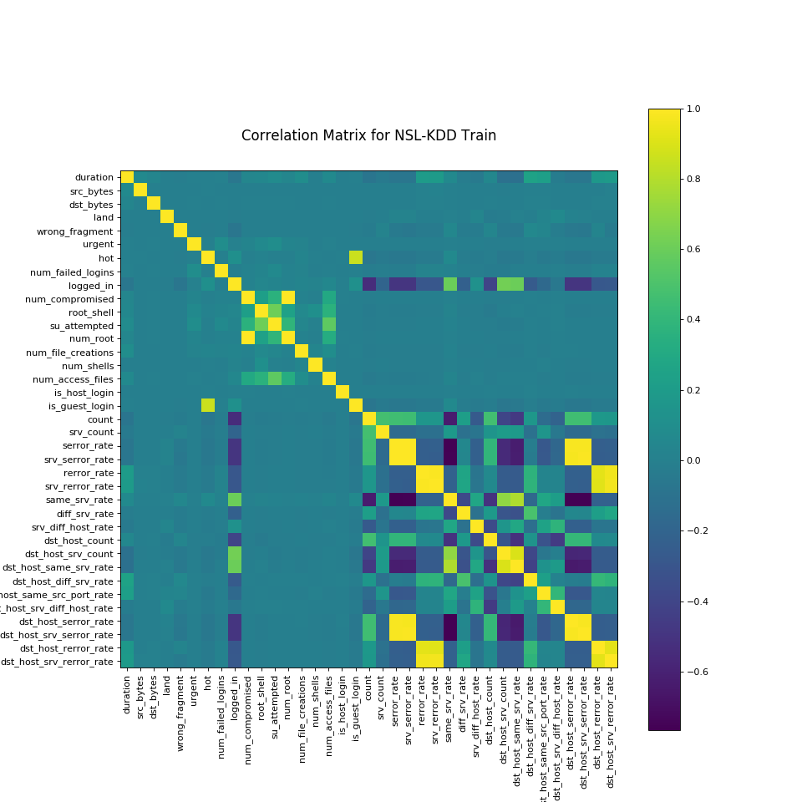

Slide 6
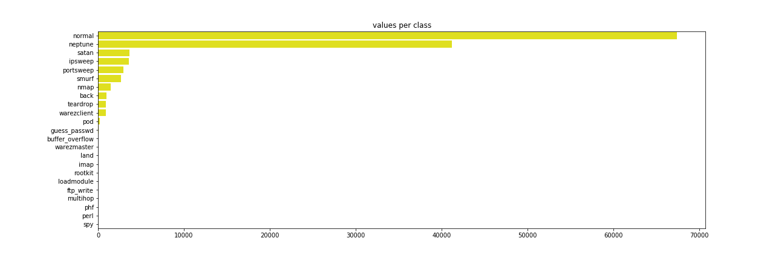
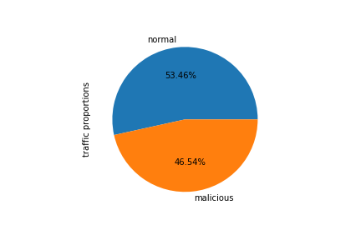

Slide 7
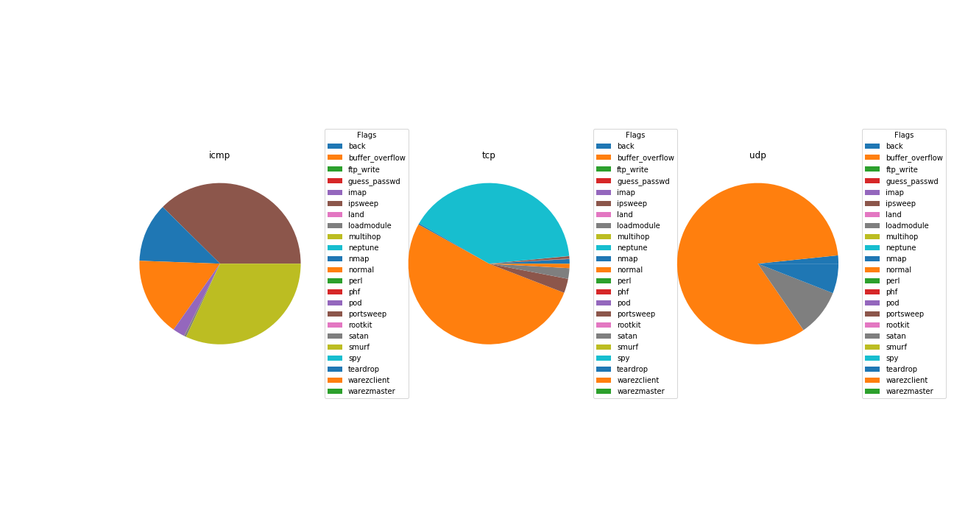

Slide 8
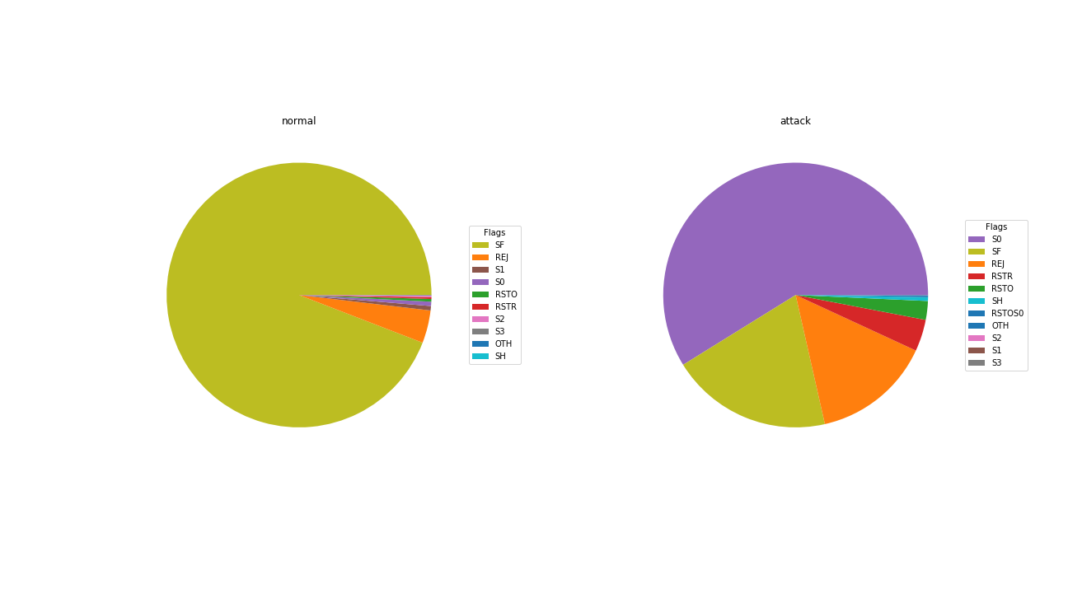

Slide 9
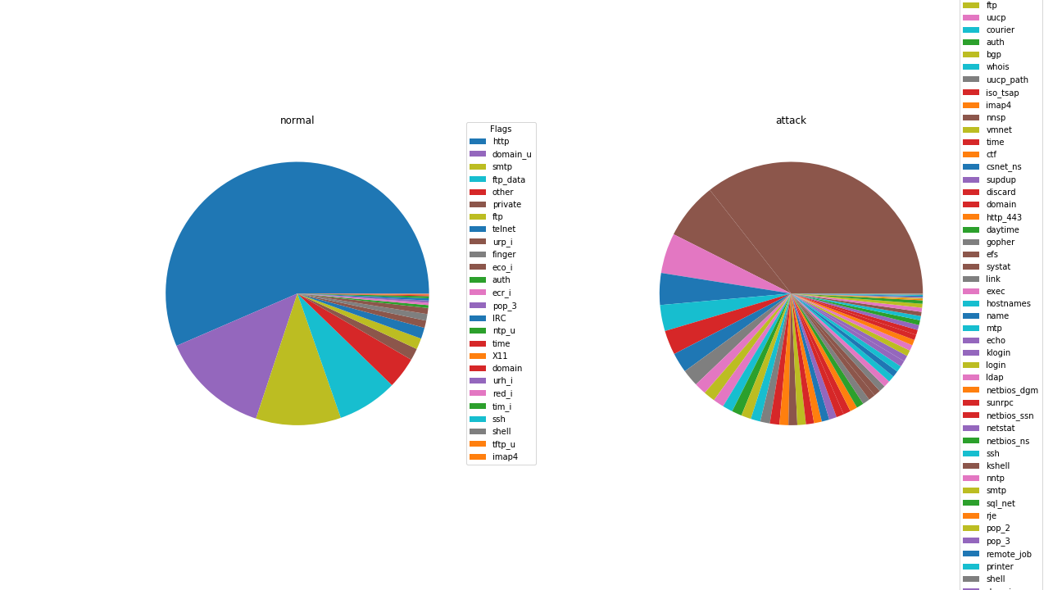

Slide 10
Model Architecture

Slide 11
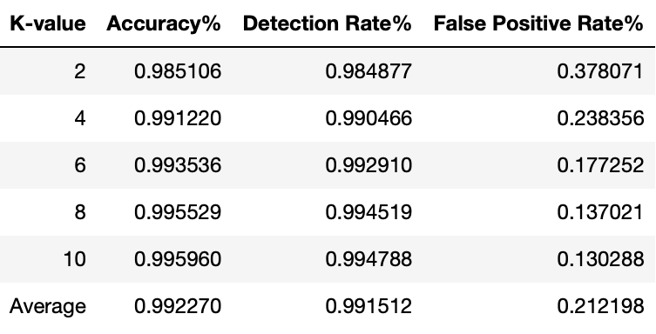
Classification Results

Slide 12
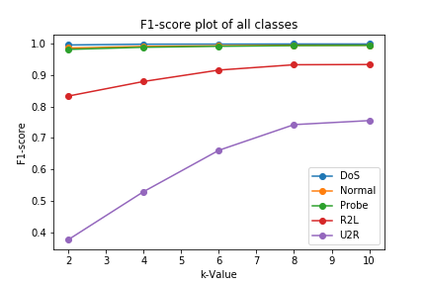
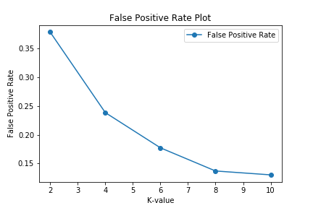
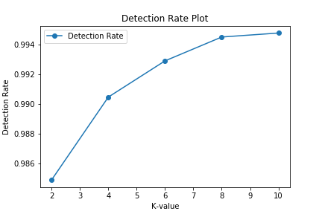
Model Results

Slide 13
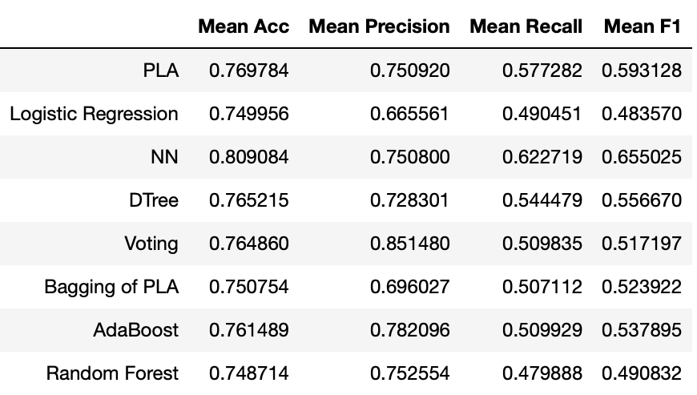
Comparison with other models

Slide 14

Future Research
Additional Data points
Random Oversampling
Pre-trained Deep Learning Models

